Slide 1
Mizuho Treasury Quick Webinar - FOMC: November Takeaways and December Early Preview - Grinch or Santa
Photo Credits: Shutterstock, FT
September 2024
Notes:
Good afternoon. First and foremost, thank you for your time to tune in. For those who tuned into the very entertaining US presidential Trump-Harris Debate yesterday, I certainly cannot provide higher entertainment value but I will aim to be more informative.
Once again, I am BH, I am one of the macro economist, Asia Oceania Treasury Department of Mizuho Bank.
For those who joining us for the first time, thank you for joining me today and for those who are tuning in after our June update, welcome back as well.
During this webinar, I will be giving a quick update on the upcoming FOMC next week, while I am allocated 30mins, I will just try to take around 20-25 mins and leave some time for Q and A which is done through the chat box as I am told by the organizers. After that, I will pass on to Kiyota-san who is one of Mizuho’s many sales product expert who will brief you about Fxweb.

Slide 2
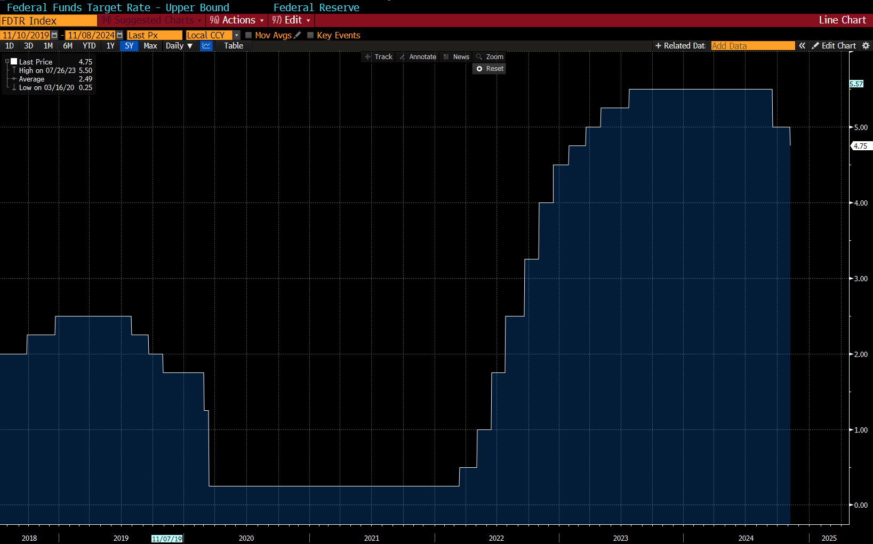
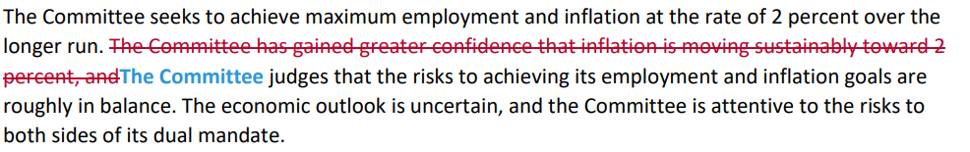
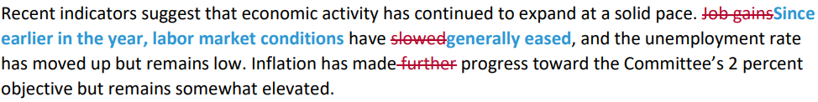
1a. Takeaways from November FOMC

Slide 3



1a. Takeaways from November FOMC
Economic activity has continued to expand at a solid pace
Labour market conditions are less tight than before the pandemic
It is not permitted under law for the Fed to remove the Fed Chair. He would not resign if asked to leave.
Doesn’t rule in or out a December rate cut
We don’t know what the timing or substance of economic policy changes going forward. The Fed is not going to assume or guess what’s going to happen. In the near term, the election will have no effect.
We don’t guess, we don’t speculate and we don’t assume.

Slide 4
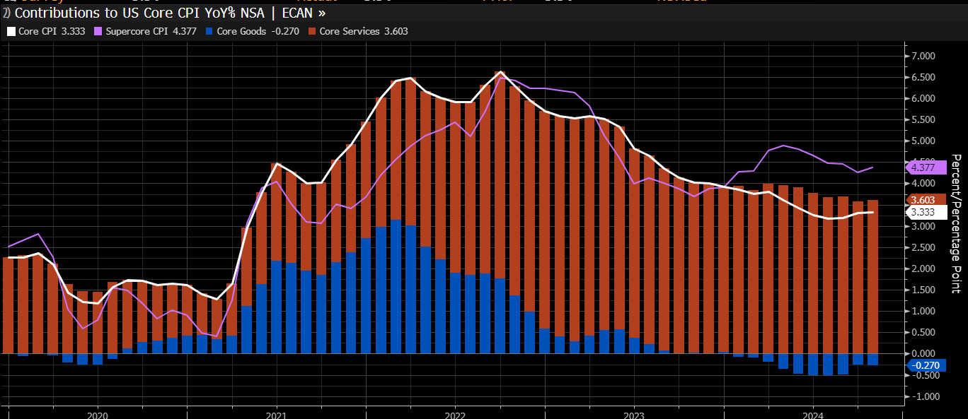
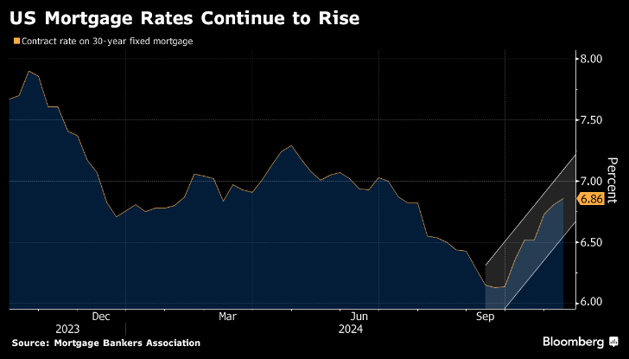
2. US CPI: Back to demand and supply debates?
Difficult Last Mile Inflation
Housing – Double Edge Sword
0.3% MoM on Core CPI
Tariffs Complication

Slide 5
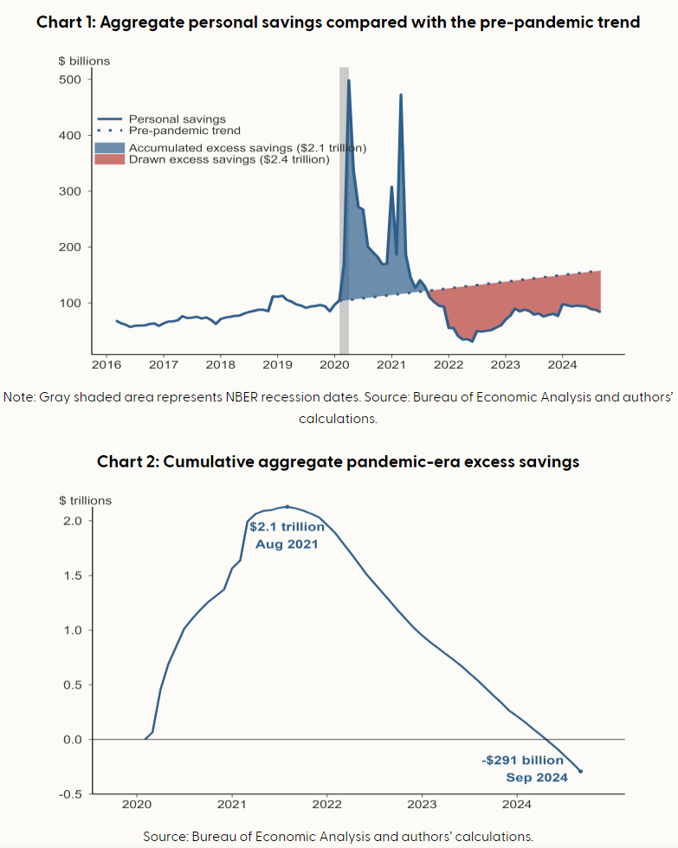
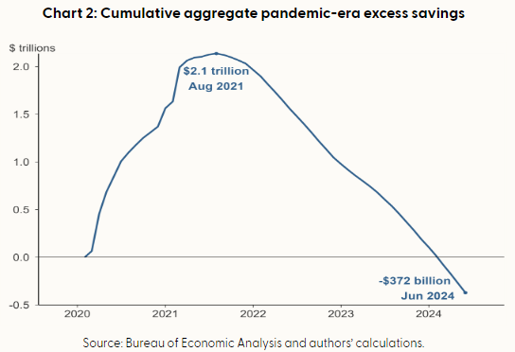

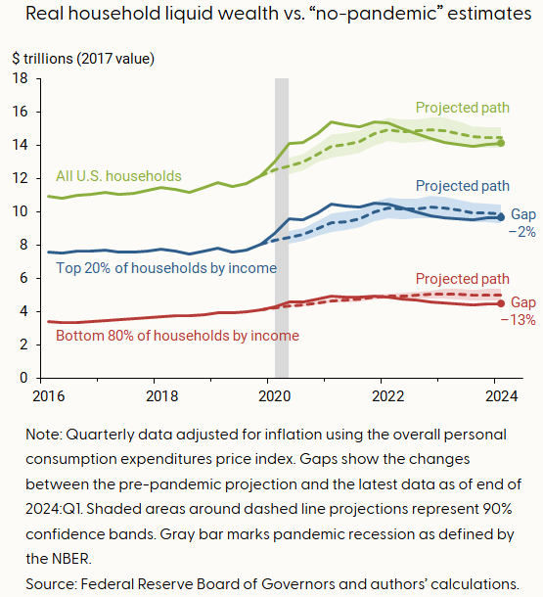
3. December FOMC: Grinch or Santa
Notes:
We focus on “real” liquid assets, adjusting for inflation by dividing all assets by the price index for personal consumption expenditures and expressing wealth levels in 2017 U.S. dollars. This adjustment for inflation keeps household purchasing power fixed over the 2016–2024 sample period. We compare the evolution of actual real household liquid wealth (solid lines) with hypothetical “no-pandemic” scenarios (dashed lines). Using the local projections method of Jordà (2005), we estimate out-of-sample projections separately for the two distinct groups and for households overall by using data only up to the fourth quarter of 2019—just before the start of the pandemic recession in the first quarter of 2020.
Our estimates suggest that middle- and lower-income households spent all of their pandemic-era liquid wealth by late 2021, while higher-income households’ extra funds lasted until the second half of 2022. The latest estimates through the first quarter of this year indicate that the current level of liquid wealth that higher-income households hold is just below the pre-pandemic projection (–2%), while the level for middle- and lower-income households is significantly below projection (–13%).

Slide 6
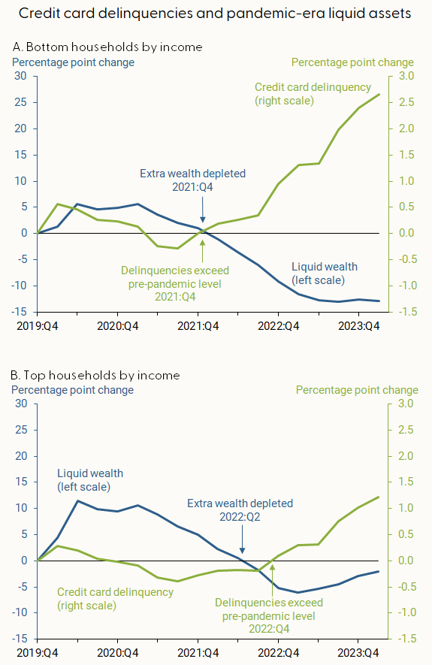
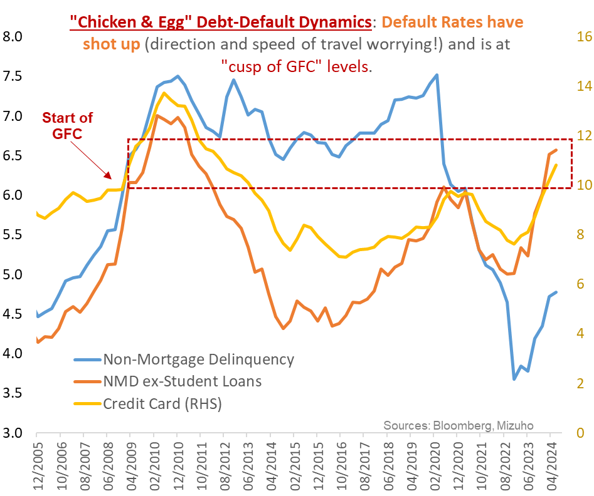
3. December FOMC: Grinch or Santa
US Consumer - Tightening Cash-flows
Drawdown of savings, increased credit (and attendant servicing burden) and softening wage gains translate into tighter consumer cash-flows.
In turn the hit on demand will have negative multiplier effects at the margin, which significantly dampen growth outcomes; even if an outright recession is averted.
For a Fed that is decidedly not setting out to break something, this will be a jolt out of the Type 2 error resulting from the earlier Type-1 error.
Notes:
While credit card delinquencies currently sit above pre-pandemic levels for households across all income groups, middle- and lower-income households (panel A) crossed this threshold about four quarters earlier than higher-income households (panel B). In addition, the share of borrowers with seriously delinquent credit card debt is notably higher for the bottom households by income than for the top households by income. Households in the bottom income group currently have higher credit utilization rates and significantly smaller cushions in the face of financial downturns than other income groups

Slide 7
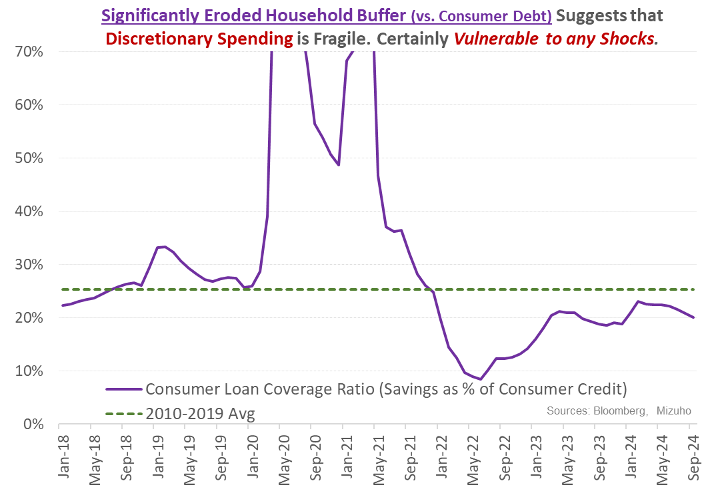
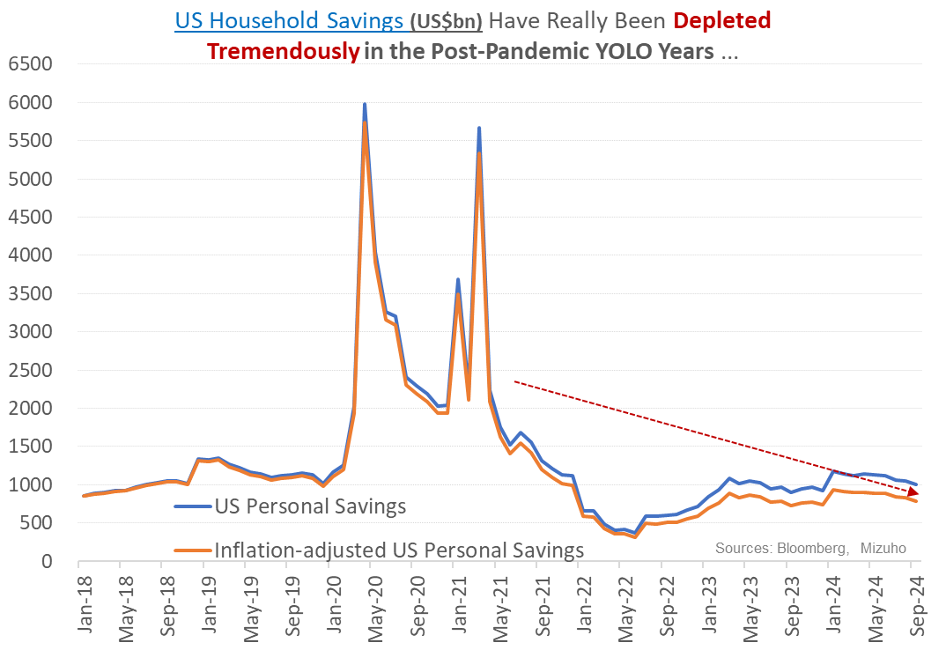
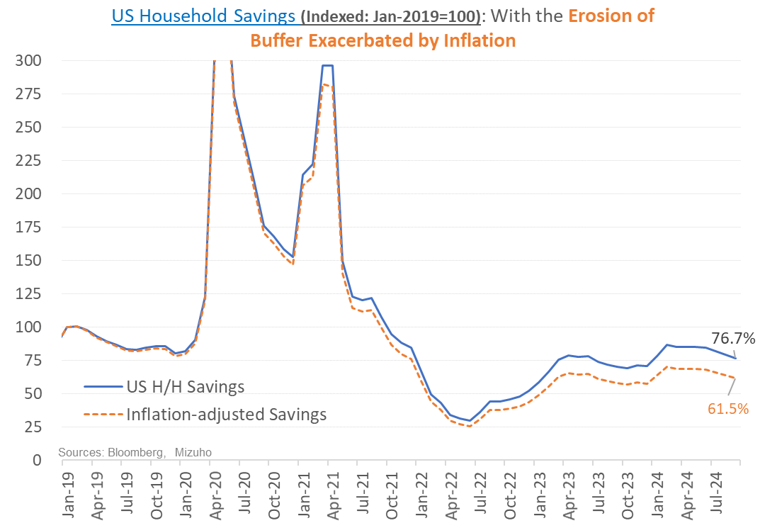
December FOMC: Grinch or Santa
US Consumer - Tightening Cash-flows
Drawdown of savings, increased credit (and attendant servicing burden) and softening wage gains translate into tighter consumer cash-flows.
In turn the hit on demand will have negative multiplier effects at the margin, which significantly dampen growth outcomes; even if an outright recession is averted.
For a Fed that is decidedly not setting out to break something, this will be a jolt out of the Type 2 error resulting from the earlier Type-1 error.
“Type-1” Error: Wrongly rejecting null hypothesis of inflation risks.
“Type-2 Error: Wrongly failing to reject null hypothesis of persistent inflation risks

Slide 8
3. December FOMC: Remaining Signposts to Watch - Santa's Elves or Grinch Spirit
Labour Market
NFP Rebound Expected on 6 Dec
Prior Revisions to be Watched for
Strikes – Boeing
Hurricanes (Milton and Helene)
Need Driven vs Supply Driven

Slide 9
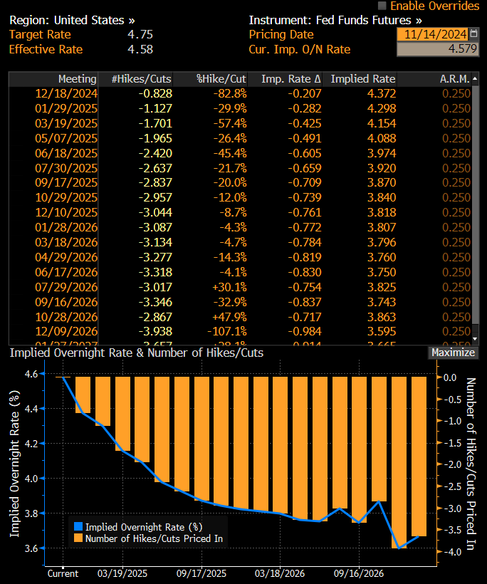
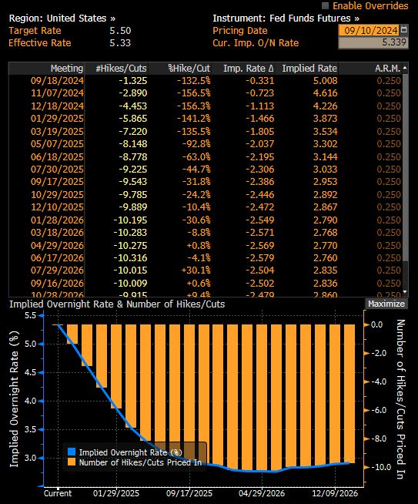
3. December FOMC: Mind the Gap – Fed and Markets

Slide 10
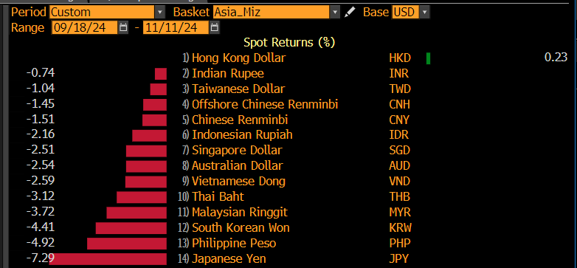
3. FX Outlook - EM-Asia: Examining the FX "gains" since September FOMC

Slide 11
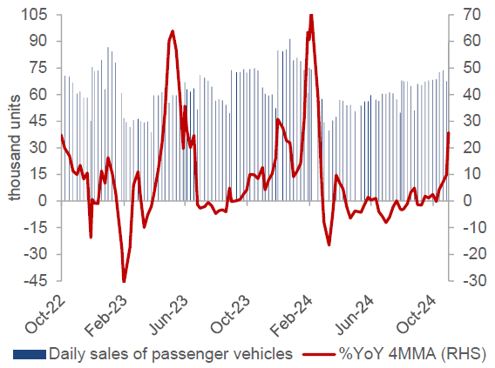
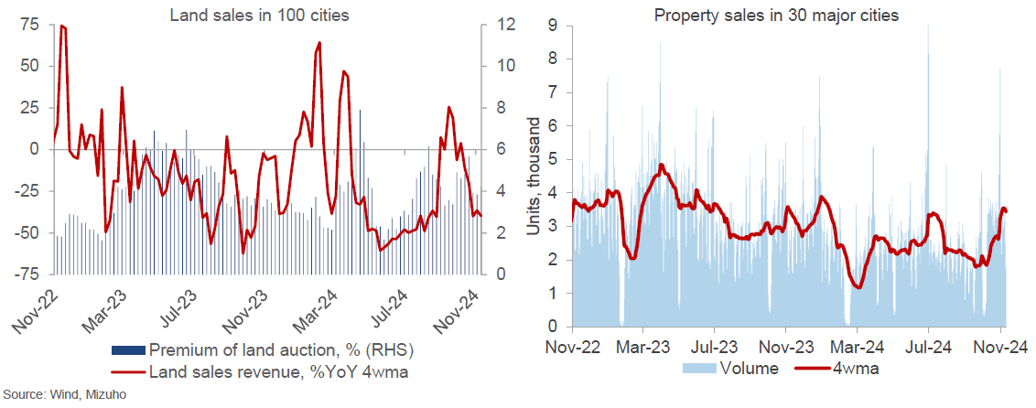
3. FX Outlook - China's Dragon Year: Of Wood and Fire - A Brief Take on Stimulus
Stimulus
Cash for Clunkers
Property Market Restrictions Removal
Local Government Concerns
10 trillion debt relief – Tepid reaction
  Expectations
  Lack of fiscal support
  LGFV concerns remains
Notes:
China has announced a RMB10trn relief plan to address hidden local debt following a week-long session of the Standing Committee of the National People’s Congress. However, the market reaction was tepid, as 1) the plan granted an increase of RMB6trn in local government debt quota, aligning with earlier reports from Reuters and Caixin; 2) the package lacks additional support for the property market or domestic consumption; and 3) there is no support mentioned at the central level.
Additionally, the government acknowledged only RMB14.3trn of hidden local debt, significantly lower than market and IMF estimates.
<30% of LGFV debt qualified as implicit local debt
Furthermore, the Ministry of Finance acknowledged only RMB14.3trn of hidden local debt, significantly lower than market estimates. Hidden debt is primarily raised through local government financing vehicles (LGFVs), with estimates on the size of LGFV debt varying between RMB40trn to RMB65trn. According to the latest data from nearly 2,600 LGFVs available on Wind, the interest-bearing liabilities of LGFVs amounted to RMB49.9trn at the end of 1H24.
Using company data gathered from Wind, we estimate that the interest-bearing liabilities of China’s local government financing vehicles (LGFVs) totaled RMB49.9trn at the end of 1H24, with 50-55% of these entities not having sufficient cash to over their maturing debt.
While the debt swap plan may not fully resolve LGFV debt issues, we continue to anticipate further fiscal support targeting domestic consumption in the coming months, especially given the challenging trade outlook during Mr. Trump’s second term as the US president.
Minister Lan has also indicated substantial room for increasing the fiscal deficit at the central level, with several additional measures to be rolled out soon, including issuing special sovereign bonds to replenish national bank capital and funding a wider range of projects with special local government bonds. Note that authorities have already issued guidelines for acquiring undeveloped or idle land from developers with special local government bonds.

Slide 12
Trump 2.0: A New Era
Weaker CNH, AXJ & MXN
Weaker EUR
Elevated Global Threats
Near-term USD Resilience
Trump 2.0
Trade (Tariffs)
Energy/Oil
Remove Restrictions
Impose Higher China/wider Tariffs!
Infrastructure [Fiscal]
Tax Cuts [Fiscal]
Ukraine [Conflict]
Gaza [Conflict]
Pull/Cut Aid
Uncertain Israel-Saudi Dynamics
Ramp-up Spending?
Extend Tax Cuts
Higher Inflation?
Tempers
Macro Rubio
Mike Waltz
Ms, Noem Krist
Lee Zeldin's
Mike Huckabee
Higher Yields
Higher Term Premium
Notes:
First, I will touch on Trump 2.0., the elections may be still some time away but as the months pass markets will increasingly price in the odds of trump 2.0 especially towards the end of the year
On acknowledge the risk created by Donald trum, it is one thing for some to dislike Trump but that does not should not allow us to dismiss the risks of him being re-elected or discount the probability that he may again become the next US president.
Today, I will stick to a macro focus, I will not be touching on the intricacies of how Trump is leading in the Republican nomination over Haley and the prospects of him facing off against Joe Biden.
I will certainly not want to make a fool of myself here especially after I have heard from Vishnu that Kobata-san is the geo-political expert in this area.
What we will focus on is Donald Trump’s potential impact on USD and concentrate on potential economic policies and market implications.
On trade, his inclinations to impose higher tariffs on Chines imports as well as widening the base of Chinese imports subjected to tariffs, it is likely to negatively impact the RMB and also have consequent impact on em-asia fx.
Also, higher tariffs which imply higher prices for imports leading to stronger price pressures may help to assist UST yields higher.
On Ukraine, Trump has displayed a tendency to want to cut aid to Ukraine and also encourage Russia to ‘do whatever the hell they want’ to any NATO country that doesn’t pay enough.
This elevates geo-political threats and destabilizes Europe and weakens prospects of EUR recovery.
Europe will need to ponder even more spending on military spending which either diverts spending in other areas or raises fiscal deficits.
Similarly, his volatile nature imply that on the gaza conflict there Israel-Saudi dynamics may become very uncertain.
Turning to energy, he has not appeared to be very green or environmental and as such he may remove restrictions on drilling and encourage already high US production levels. This will lead to near term USD resilience because the US is a net energy exporter while the likes of Europe is a net importer along with a lof of countries in our region.
As for fiscal policy, he is likely to ramp up infrastructure spending and extend tax cuts, this will lead to higher yields and also a higher term premium because the issuances for infrastructure might be on the longer end.
All in, these factor remain a net positive for the USD

Slide 13
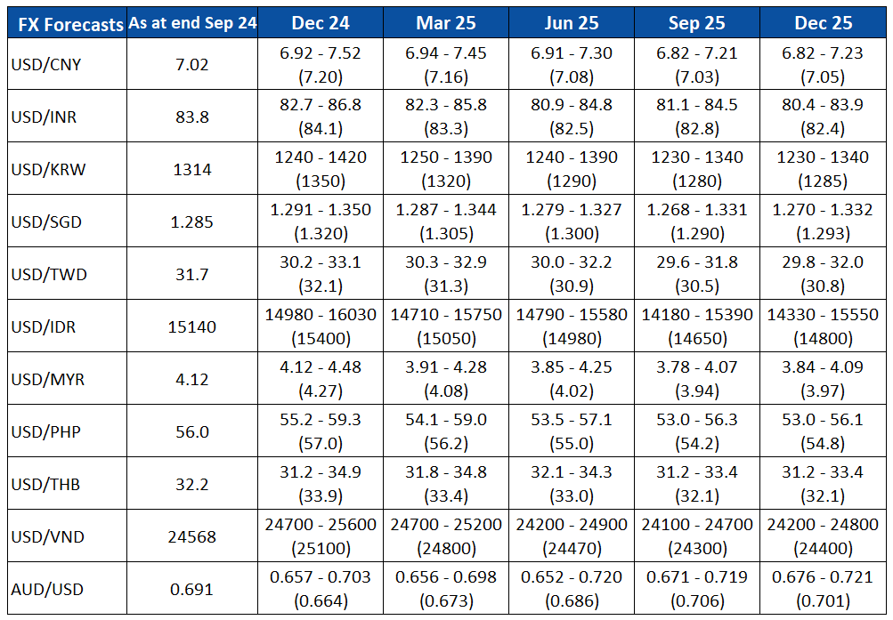
Q and A
Kindly Drop Your Questions in the Chat Box
Notes:
Lastly, while we have also acknowledge the tendency for a softer USD, we continue to see threats to one way bearish USD bets.

Slide 14
Mizuho Global e-Banking
FX Web Service
November 2024
Mizuho Bank
Singapore Corporate Banking Department
Global Transaction Banking Department Asia & Oceania Office
Asia & Oceania Treasury Department

Slide 15






Additional service FX Web
Online FX service
Features & Benefits | Users will deal FX transaction through Mizuho Global e-banking (MGeB)
 | Users will have indication quickly and timely
 | Do not need to submit confirmation letter
 | Users can check the list of historical transactions ( Users can refer to the reference number on FX Web )
POINT
Available Currency pair | USD/SGD, JPY/SGD, EUR/SGD, THB/SGD, AUD/SGD, GBP/SGD, CHF/SGD, CAD/SGD,NZD/SGD, GBP/USD, EUR/USD, AUD/USD, USD/JPY, EUR/JPY, USD/THB, USD/CHF, NZD/USD, USD/CAD, USD/DKK, EUR/GBP, USD/NOK, USD/SEK, USD/CNH, CNH/SGD (For currency pairs not listed here, please contact us)
【New workflow for FX dealing】
Step1 Call for the deal and Done FX dealing
Done FX dealing and Confirm through one platform
Step2 Need to sign back the Confirmation to Bank
Do not need to sign back the Confirmation to Bank
Check indication
Done FX dealing
Confirm the deal
You
Bank
You/User
Function | Opening time of FX Web service
FX Transaction | Weekdays 8：30～17：00 * *Exclude value same day transaction(Value Same day transaction will be available until 11:00AM in the FX Web) Above service hour is subject to change without prior notice
Inquiry /Setting | Weekdays 7：00～23：00 Saturday 7：00～21：00
Notes
The customer needs to apply with documents to add online FX service.
For FX transactions done after 16:00, the contract date will be the next business day
Online FX Service can provide FX Forward transactions within 1 Year, also can provide value same day transactions
Dealing FX Forward is subject to bank’s assessment. For your eligibility, please check with the branch

Slide 16
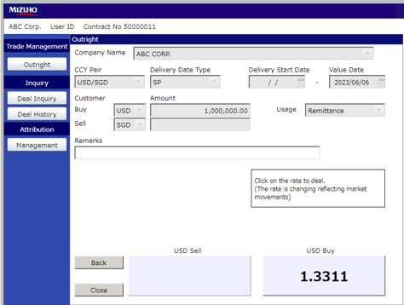
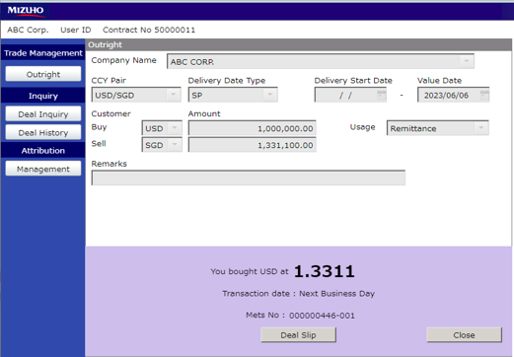
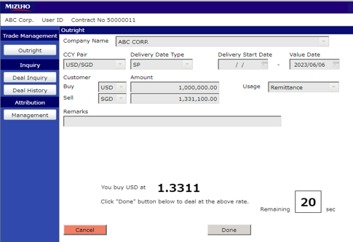
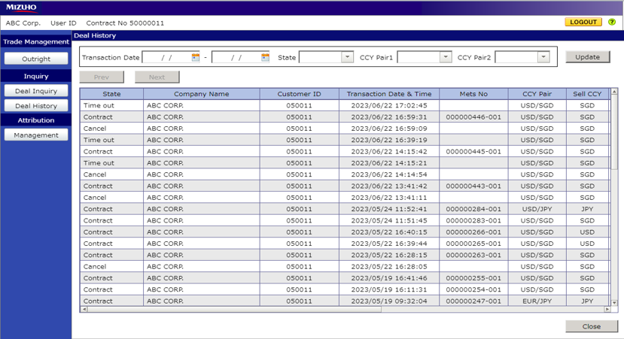
Sample Screen of FX web
1.Transaction Input
You can input the Amount, Currency pair and Value date for Outright
3.Download Deal Slip
You can print out the Deal Slip by clicking the [Deal Slip] button.
POINT
1
3
2.Deal Done
Click the［Done］button.
4.Manage historical data
You can view the historical deal information
2
4

Slide 17
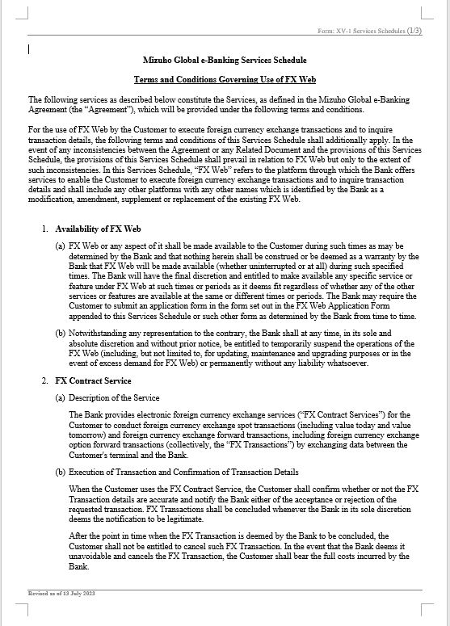
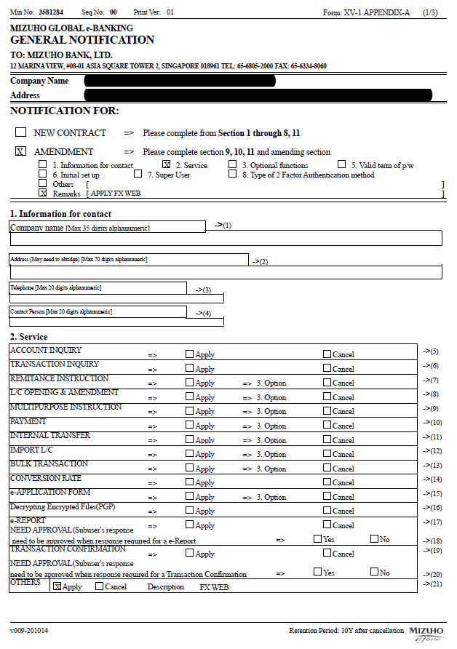
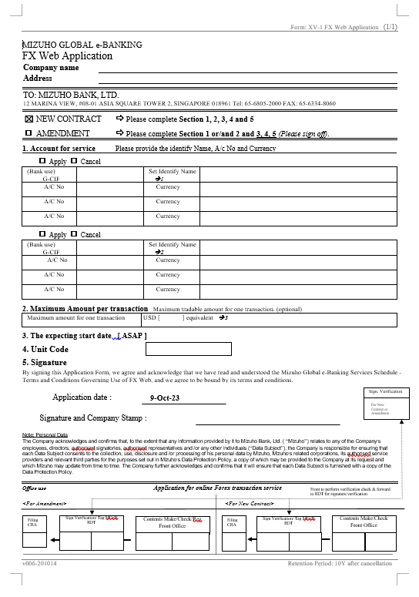
Necessary Documents to Start the online FX service
Necessary
Documents
To Start
Online FX Service
1
Terms and Conditions Governing Use of the Mets Global Service(No signature required)
2
MIZUHO GLOBAL e-BANKING Appendix A for Mets Global(Signature required)
3
MIZUHO GLOBAL e-BANKING FX Web Application(Signature required)
Notes:
The above documents are examples of customers who have already signed a contract with MIZUHO GLOBAL e-BANKING(MGeb)
If Customer dose not have a MGeb service, we would appreciate it if customer would consider joining MGeb service first
Terms and Conditions Governing Use of the Mets Global Service
2. MIZUHO GLOBAL e-BANKING Appendix A for Mets Global
3. MIZUHO GLOBAL e-BANKING FX Web Application
Note: The above consent letter format is a sample and the format differs by Mizuho branches.

Slide 18
Setup before FX Web Use
After applying for FX Web, the following two settings are required before customer can use the service
(Both settings must be made by Super User)
FX Web Usage Settings (p. 5)
Local Service Usage Settings (p. 6)
Changes to the settings in "1. FX Web Usage Settings" will be reflected on the next business day.
Please complete the setup by one business day before to the actual execution of the FX transaction.

Slide 19
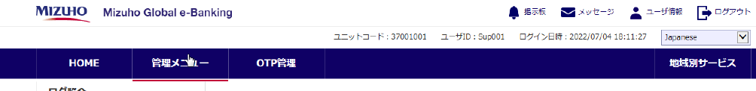
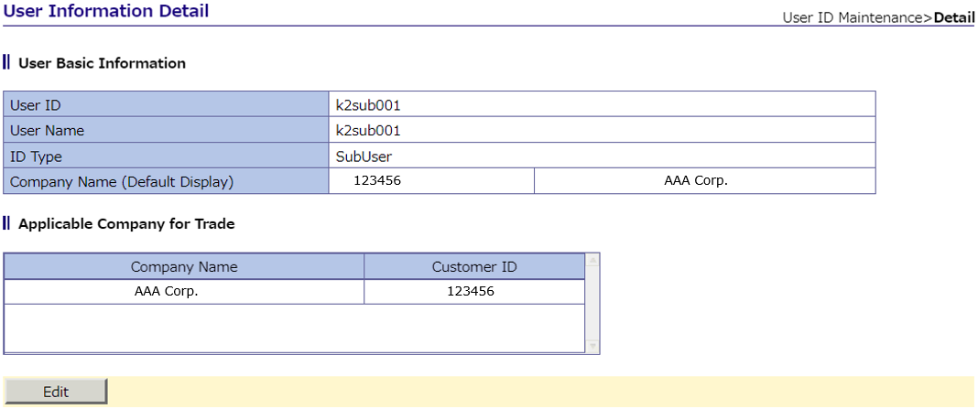
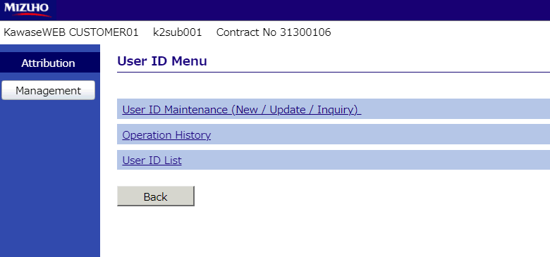
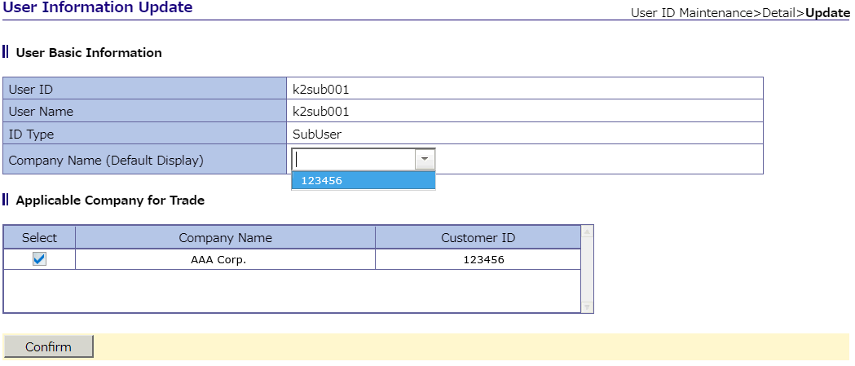
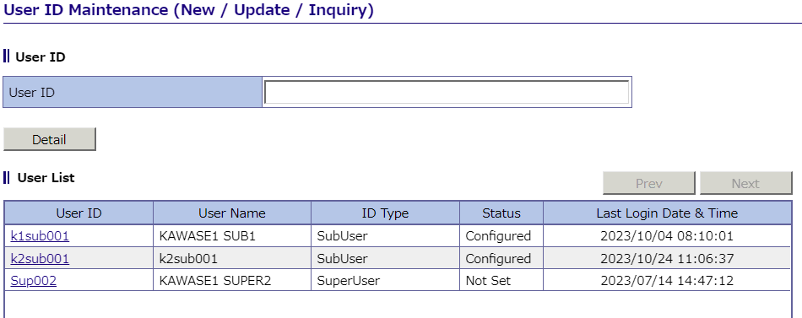
1.FX Web Setup
1, Login to Mizuho Global e-Banking (MGeB) with Super User ID and select FX Web from “Local Service”
4, Click "Edit" to display the selected user information.
2, Select "User ID Maintenance" on the screen
5, Select "Company Name" from the list and click "Confirm
3, Select the Sub User ID to be authorized.
6, The registration contents screen is displayed.
If all done the check, click "Update" to reflect the registration.
*The attached image may differ from the actual screen display.

Slide 20
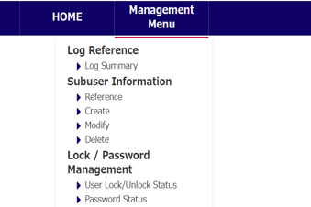
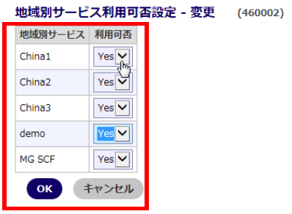
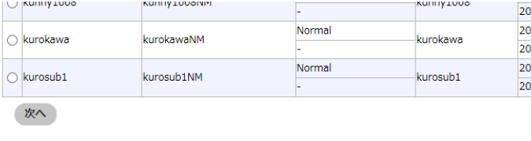

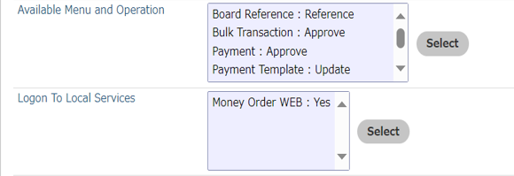
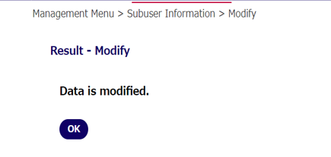
2. local service use setting
1、Login to Mizuho Global e-Banking (MGeB) with your Super User ID, and select Administration Menu > Sub User Information > Change
4，Change "FX Web" to "Yes" from the pop-up window and click "OK.
2，Select the user whose settings you want to change and click "Next
5，Confirm that the changes are reflected on the original screen (the screen in item 3) and click "OK".
3，Click "Select" for services by region
6，Configuration change is completed.
*The attached image may differ from the actual screen display.

Slide 21
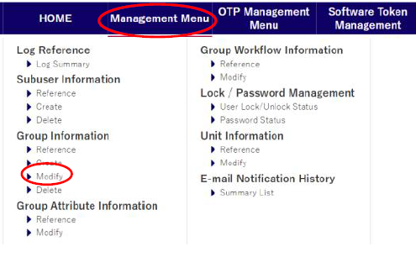
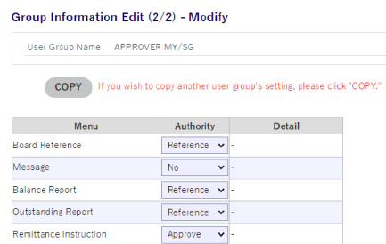
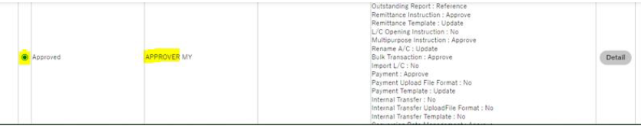
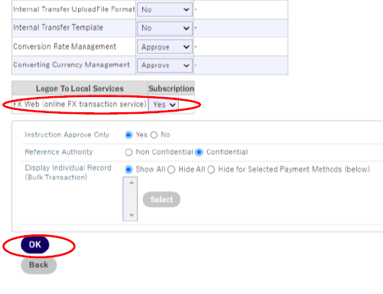
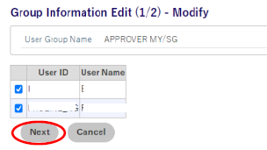
2. local service use setting
(For group workflow setting customer)
1, Login to Mizuho Global e-Banking (MGeB) with your Super User ID, and select Management Menu > Group Information > Modify
4，Click “Yes” for FX Web (online FX transaction service)
Click OK
Message “Ready to execute”, click OK (Ensure you see a message “Data is modified”
2，Select Approver Group and Click Continue
3，Click Next (Important: Do not remove the tick beside the User ID)
*The attached image may differ from the actual screen display.

Slide 22
Disclaimer
This Presentation is for general information only and is not intended to constitute any investment, legal, accounting, taxation or other advice of any kind from Mizuho Bank, Ltd. or any of its affiliates (individually or together, as the context may require or admit, “Mizuho”).
While every care has been taken in preparing this Presentation, no representation, warranty or other assurance of any kind is made with respect to the accuracy, completeness or suitability of any information in the Presentation for any purpose, including any data obtained from third party sources, and neither Mizuho nor any officer, director, employee, agent, advisor or controlling person of Mizuho shall have any liability to anyone relating to or arising from the use of any of the information in the Presentation or for any error, omission or misstatement thereof (negligent or otherwise).
All opinions, estimates, forecasts, projections or forward-looking statements contained herein (if any) may not be relied upon as facts nor as any representation or guarantee of future results. No representation is made as to the reasonableness of the assumptions made within or the accuracy or completeness of any modelling, valuation or back-testing. Mizuho does not have any obligation to update any of the information contained in this Presentation.
This Presentation may not be modified, reproduced, copied, distributed or disclosed to third parties in whole or in part and no commercial use or benefit may be derived from this Presentation without the prior written permission of Mizuho.

Slide 23
Disclaimer
Important Information
This publication has been prepared by Mizuho Bank, Ltd. (“Mizuho”) and represents the views of the author. It has not been prepared by an independent research department and it has not been prepared in accordance with legal requirements in any country or jurisdiction designed to promote the independence of investment research and is not subject to any prohibition on dealing ahead of the dissemination of investment research.
Disclaimer
Unless otherwise stated, all views or opinions herein are solely those of the author(s) as of the date of this publication and are not to be relied upon as authoritative or taken in substitution for the exercise of judgement by any recipient, and are subject to change without notice.
This publication has been prepared by Mizuho solely from publicly available information. Information contained herein and the data underlying it have been obtained from, or based upon, sources believed by us to be reliable, but no assurance can be given that the information, data or any computations based thereon are accurate or complete. This publication provides general background information only. It is information in summary form and does not purport to be complete. This publication has been prepared for information purposes only and is not intended by Mizuho or its affiliates to constitute investment, legal, accounting, tax or other advice of any kind and all recipients of this publication are advised to contact independent advisors in order to evaluate the publication, including, without limitation, the suitability of any security, commodity, futures contract or instrument or related derivative (hereinafter, a “financial instrument”), product or strategy herein described. This publication is not intended to be relied upon as advice to investors or potential investors and does not take into account investment objectives, financial situation or needs of any particular investor. It is not intended for persons who are Retail Clients within the meaning of the United Kingdom’s Financial Conduct Authority rules nor for persons who are restricted in accordance with US, Japanese, Singapore or any other applicable securities laws.
This publication has been prepared for information purposes only and is not intended by Mizuho to market any financial instrument, product or service or serve as a recommendation to take or refrain from taking any particular course of action or participate in any trading or other strategy. This publication is not an offer to buy or sell or a solicitation of any offer to buy or sell any security or any of the assets, businesses or undertakings described herein, or any other financial instrument, nor is it an offer to participate in any trading or other strategy, nor a disclosure document under applicable laws, rules, regulations or guidelines. Nothing contained herein is in any way intended by Mizuho or its affiliates to offer, solicit and/or market any financial instrument, product or service, or to act as any inducement to enter into any contract or commitment whatsoever. Neither the author, Mizuho nor any affiliate accepts any liability whatsoever with respect to the use of this publication or its contents or for any errors or omissions herein.
Mizuho and its affiliates, connected companies, employees or clients may take the other side of any order by you, enter into transactions contrary to any recommendations contained herein or have positions or make markets or act as principal or agent in transactions in any securities mentioned herein or derivative transactions relating thereto or perform or seek financial or advisory services for the issuers of those securities or financial instruments.
All of the information contained in this publication is subject to further modification without prior notice and any and all opinions, forecasts, projections or forward-looking statements contained herein shall not be relied upon as facts nor relied upon as any indication of future results. Opinions stated in this publication are subject to change without notice. Future results may materially vary from such opinions, forecasts, projections or forward-looking statements. The information contained in this publication may not be current due to, among other things, changes in the financial markets or economic environment. Mizuho has no obligation to update any information contained in this publication. Past performance is not indicative of future performance.
This is a strictly privileged and confidential publication. This publication contains information addressed only to a specific individual and is not intended for distribution to, or use by, any person other than the named addressee or any person or entity in any jurisdiction or country where such distribution or use would be contrary to law or regulation. Save with Mizuho’s prior written consent, you may not disclose, divulge, reproduce or furnish any information contained herein to any other party. Please notify the sender immediately if you have mistakenly received this publication.
Singapore: Mizuho is licensed as a bank under the Banking Act (Chapter 19) of Singapore, and is regulated by the Monetary Authority of Singapore.
Japan: Mizuho is authorised and regulated by the Financial Services Agency of Japan.
United Kingdom / European Economic Area: In the UK, Mizuho is authorised by the Prudential Regulation Authority and subject to regulation by the Financial Conduct Authority and limited regulation by the Prudential Regulation Authority. Details about the extent of MHBK's regulation by the Prudential Regulation Authority are available upon request. This publication may also be distributed by Mizuho International plc (“MHI”). MHI is authorised by the Prudential Regulation Authority and regulated by the Financial Conduct Authority and the Prudential Regulation Authority.
United States: This publication is not a “research report” as defined in Commodity Futures Trading Commission (“CFTC”) Regulations 1.71 and 23.605. The content of publications distributed by Mizuho Securities USA Inc. (“MSUSA”) is the responsibility of MSUSA. The content of publications distributed directly to US customers by Mizuho is the responsibility of Mizuho. US investors must effect any order for a security that is the subject of this report through MSUSA.
© 2014 Mizuho Bank Ltd.

